Slide 1

LibraPulse : Scalable Library Pipeline with PySpark
FDE Project Review-4
Under the Guidance of
Dr. N Shirisha
Department of Computer Science and Engineering,
KLH CSE Bowrampet Campus
Team Members
Vivek - 2420030350
D Teja – 2420030737
Adhithya - 2420030571
1

Slide 2
Comparison with Existing Projects (2021–2026)
Feature | Existing ETL / Analytics Systems | LibraPulse (Ours)
Processing Engine | General Spark/Glue or relational + graph DB (Sharath 2026, Gupta 2025) | Apache PySpark focused on library DataFrames
Domain Focus | Company DW (Fana 2021) or student performance analytics (Gupta 2025) | Purpose-built for library data (books, members, borrowings)
Modularity | Often monolithic or tightly coupled to cloud / dual DB (Sharath 2026, Gupta 2025) | Independent modules: extract, clean, transform, load, analytics
Analytics Scope | General BI / at-risk student monitoring / company reporting (Gupta 2025, Fana 2021) | Popular books, active members, category stats + time trends
Infrastructure | Requires AWS Glue + Redshift or Neo4j + MySQL (Sharath 2026, Gupta 2025) | Lightweight: runs locally or on cluster with CSV/Parquet
Portability | Tied to specific cloud stack or dual-database paradigm (Sharath 2026, Gupta 2025) | Reusable pipeline; no mandatory cloud or special DB
2

Slide 3
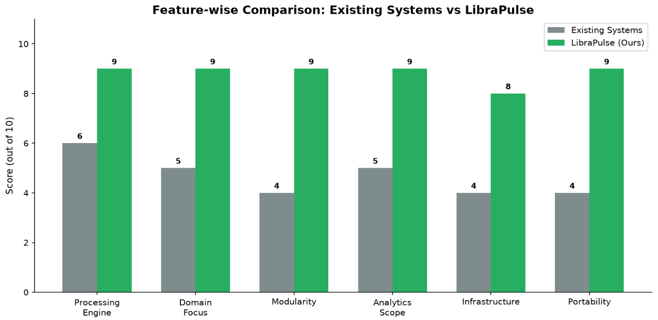
Results – Feature-wise Comparison with Existing Systems
Insight: LibraPulse scores 8–9/10 across every dimension, versus 4–6/10 for existing systems — the biggest gaps are in Modularity and Portability (+5 points each).
Insight: Infrastructure shows the smallest (but still clear) edge (4→8, +4) — LibraPulse still needs a PySpark environment, but avoids the heavier cloud / dual-DB stacks existing systems require.
3

Slide 4
What Makes LibraPulse Different
Library-Domain PySpark Pipeline
Fully Modular Stage Design
Recent works target company DW (Fana 2021) or student analytics (Gupta 2025). LibraPulse is purpose-built for books, members & borrowing records with Spark DataFrames.
Each stage (extract, clean_transform, load, analytics, visualize) is an independent reusable Python module under /src — easy to maintain and extend.
End-to-End Library Insights
Lightweight & Portable
One pipeline run delivers popular books, active vs inactive members, category-wise demand, and monthly borrowing trends — not just generic BI reports.
Unlike Glue+Redshift or Neo4j+MySQL stacks (Sharath 2026, Gupta 2025), it runs locally or on a cluster with simple CSV/Parquet I/O.
Scalability Without Redesign
Decision-Ready Outputs
Same code path handles sample data today and can scale to large volumes via Spark's distributed engine without rewriting the pipeline.
Produces cleaned datasets plus ready charts so library administrators can act on inventory, engagement, and demand immediately.
4

Slide 5
Results – Pipeline Output Summary
15
12
18
8
Books
Members
Borrowings
Active Members
records extracted
records extracted
records extracted
out of 12 (67%)
Key Findings from Analytics
Most Popular Books: The Hobbit & Atomic Habits (4 borrows each)
Top Category: Fiction (9 borrows) — followed by Technology & Self-help (4 each)
Member Activity: 8 Active vs 4 Inactive members
Borrowing Trend: Peak in March 2024 (6 borrows); steady growth from Jan–Mar
5

Slide 6
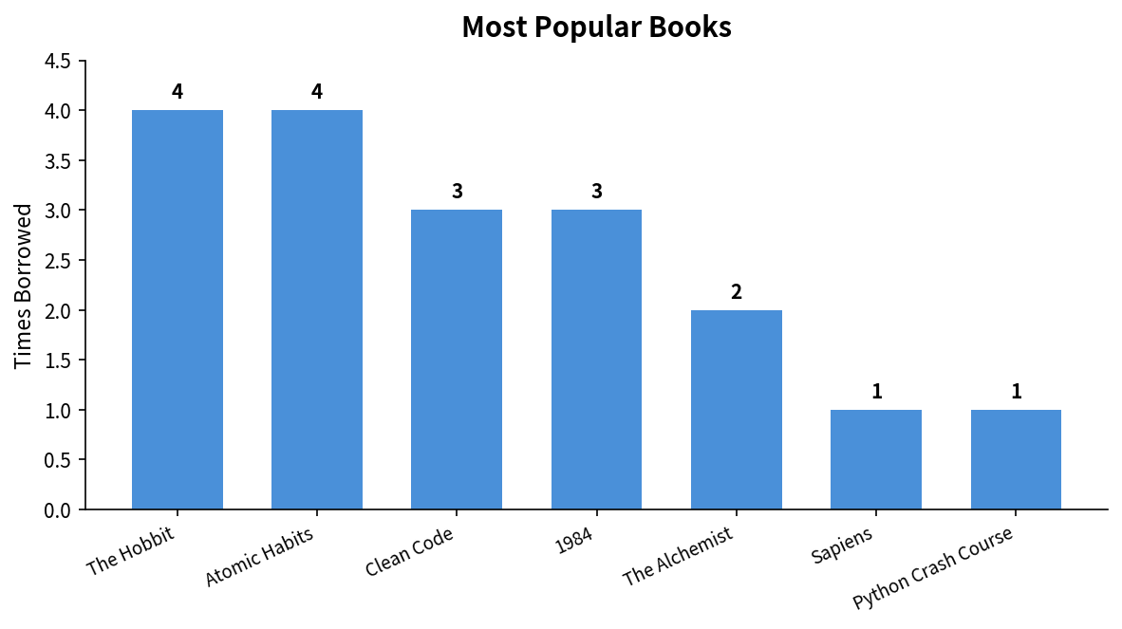
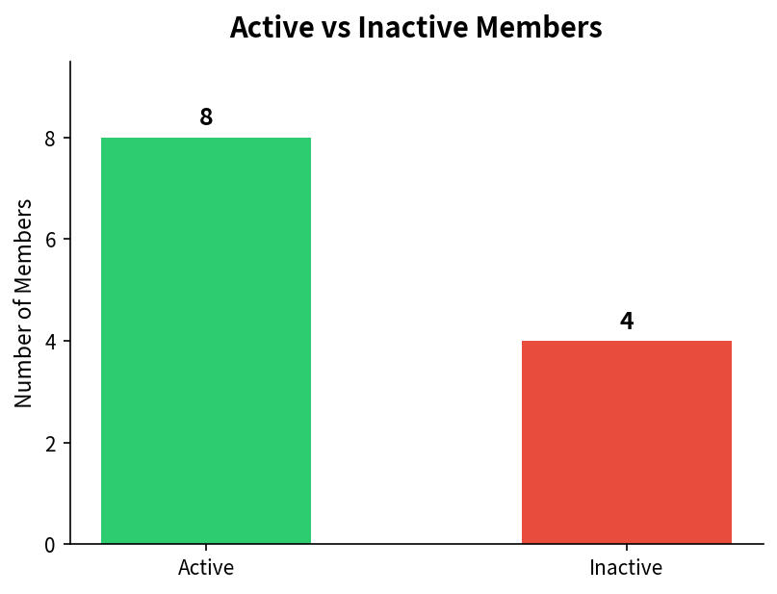
Results – Most Popular Books & Member Status
Insight: The Hobbit and Atomic Habits lead with 4 borrows each. Technical books (Clean Code, 1984) also show strong demand.
Insight: 67% of members are active. Focus engagement campaigns on the 4 inactive members to improve utilization.
6

Slide 7
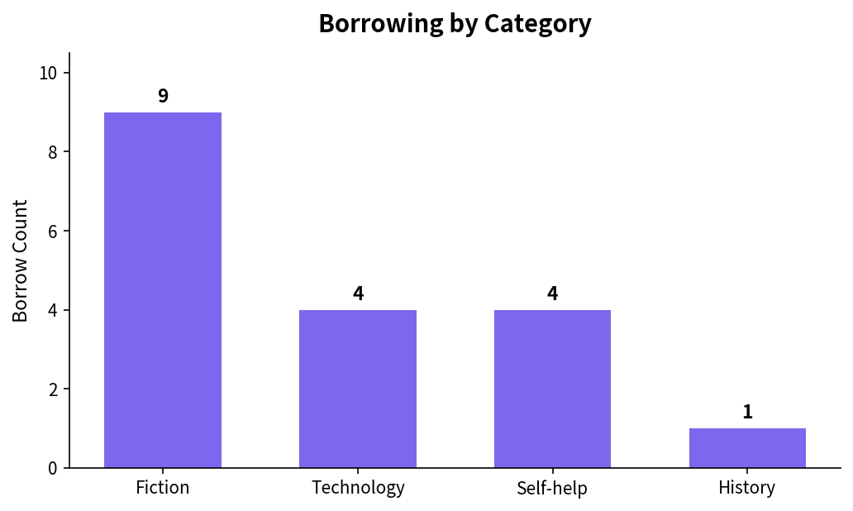
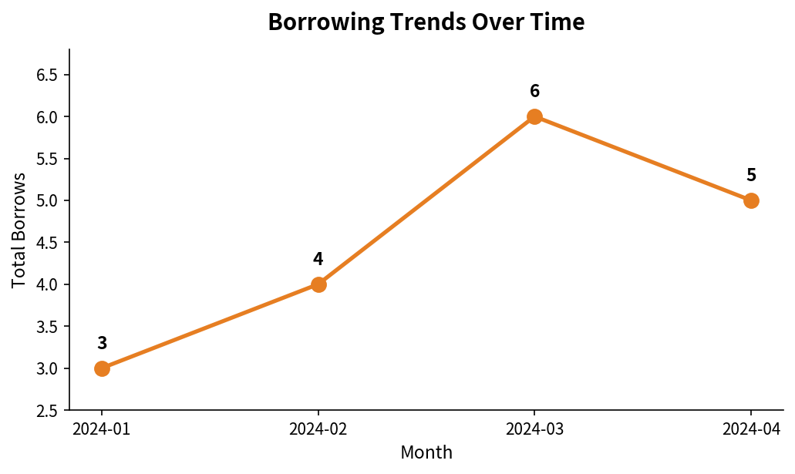
Results – Category Stats & Borrowing Trends
Insight: Fiction dominates with 9 borrows (50% of total). History has lowest demand — consider promotional displays or fewer copies.
Insight: Borrowings rose from 3 (Jan) to 6 (Mar), then settled at 5 in April. Peak activity in March suggests exam/project season demand.
7

Slide 8
Conclusion
Pipeline Successfully Built
A modular, reusable PySpark ETL pipeline was implemented for extraction, cleaning, transformation, and loading of library data.
Clear Differentiation from Recent Work
Unlike recent general DW (Fana 2021), dual-DB analytics (Gupta 2025) or cloud-heavy Glue pipelines (Sharath 2026), LibraPulse is library-specific, modular and lightweight.
Actionable Insights Generated
Identified top books (The Hobbit, Atomic Habits), dominant category (Fiction), active vs inactive members, and monthly borrowing trends.
Scalable & Decision-Ready
Layered architecture supports growth; summary reports and visualizations enable informed library management decisions.
8

Slide 9
Future Directions
01
02
03
Real-Time Streaming
Recommendation Engine
Cloud Deployment
Extend with Spark Structured Streaming to process live borrowing events as they occur.
Build a collaborative-filtering recommender using borrowing history to suggest books.
Deploy on AWS (Glue + Redshift / S3) or Azure for production-scale scheduling.
04
05
06
Interactive Dashboards
Demand Forecasting
Multi-Campus Integration
Connect Power BI / Tableau for real-time, drill-down analytics for administrators.
Apply time-series models (ARIMA / Prophet) to predict future book demand.
Scale to ingest and unify data from multiple library branches across campuses.
9

Slide 10
Thank You
LibraPulse | Team: Vivek • D Teja • Adhithya
10

